Slide 1


Titolo presentazione sottotitolo
TRAVLENDAR +
Milano, XX mese 20XX
Mandatory project: RASD Document and Design Document
Davide Rossetto - 894029
Alessandro Tatti - 883861

Slide 2

Firma convenzione Politecnico di Milano e Veneranda Fabbrica del Duomo di Milano
RASD
Aula Magna – Rettorato
Mercoledì 27 maggio 2015

Slide 3

Purpose
To describe:
the system
functional and non-functional requirements
the components
the constraints
the relationship with real world and users, providing several use cases and scenarios.
Davide Rossetto – Alessandro Tatti
Notes:
Rasd is the first document of the project and it describes the system in the complex, specifies functional (like system verifies correctness of information) and non functional requirements likes availability of the system. It specifies which components and constraints the develloppers use in the project.

Slide 4
Goal – profile management
Let the user register to the service and login via provided credentials;
Let the user manage his/her own profile;
Let the user delete his/her own profile;
Davide Rossetto – Alessandro Tatti
Notes:
The user can create your profile, and then he can modify or delete.
Users can use the app via login with credentials.

Slide 5
Goals – meetings management
Let the user insert his/her meeting in the schedule application;
Let the user modify his/her meetings in the schedule application;
Let the user delete his/her meetings in the schedule application;
Let the user specify its intent to minimize his carbon footprint;
Let the user specify a flexible break;
Let the user specify an interval time for a break;
Davide Rossetto – Alessandro Tatti
Notes:
Important goals are about meeting managment,like insert meeting used application travlendar+, modifyor delete meeting, specify and manage a break interval.

Slide 6
System goals
Let the system work efficiently by generating an alarm when a meeting is not possible within the specified time range;
Let the system indicate which best travel means is to be used for a given meeting;
Let the user indicate his/her preferences on the travel means;
Automatically the system searches for the shortest path to reach the meeting site;
Automatically the system searches the cheapest means of transport to reach the meeting site;
Automatically the system must find the specify interval time to have break.
Davide Rossetto – Alessandro Tatti
Notes:
User can specify preferences about mean of transport, path; the system generates an alarm when a meeting or break is not possible in the specify time range.

Slide 7
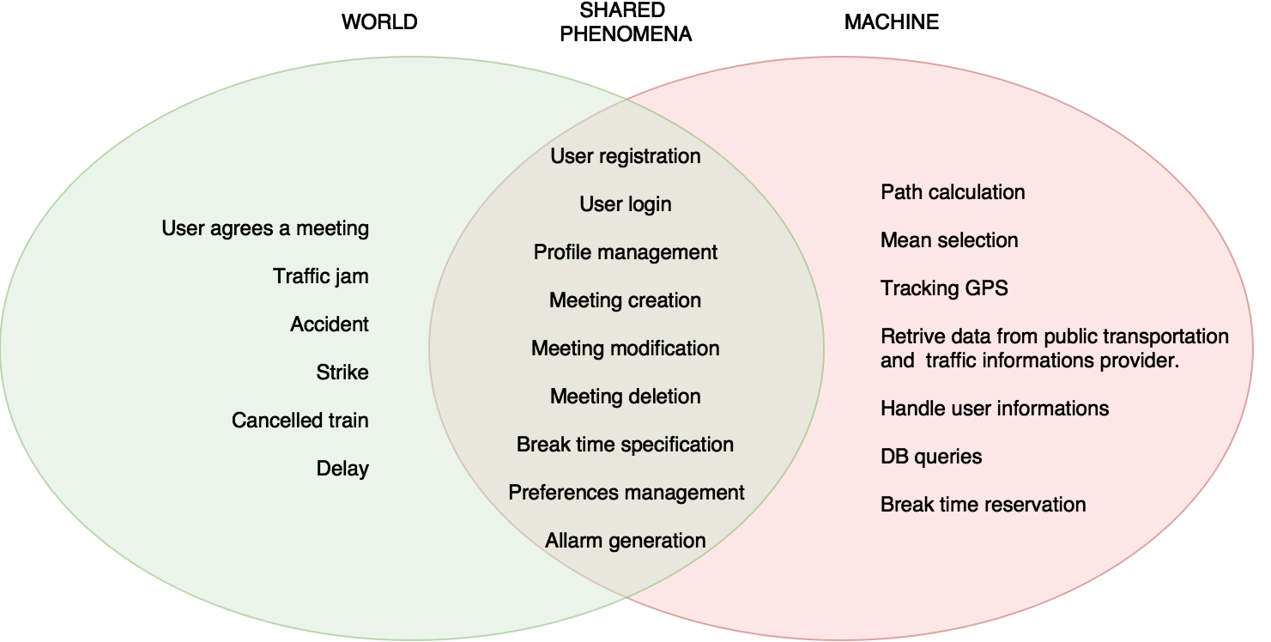
World and Machine
Davide Rossetto – Alessandro Tatti
Notes:
the world domain is a set of phenomena that the machine cannot observe; for example “user agrees a meeting” is a phenomena that the machine cannot control because it belongs to the physical world.
The machine domain is a set of phenomena located enterely in the machine; for example Path calculation is a typical machine phenomena because the machine calculates the path depending the user’s coinstraints, like mean.
shared phenomena is a set of phenomena that observed by the machine and the world; for example Meeting creation because the meeting is in physical word and the machine save the information about it.

Slide 8
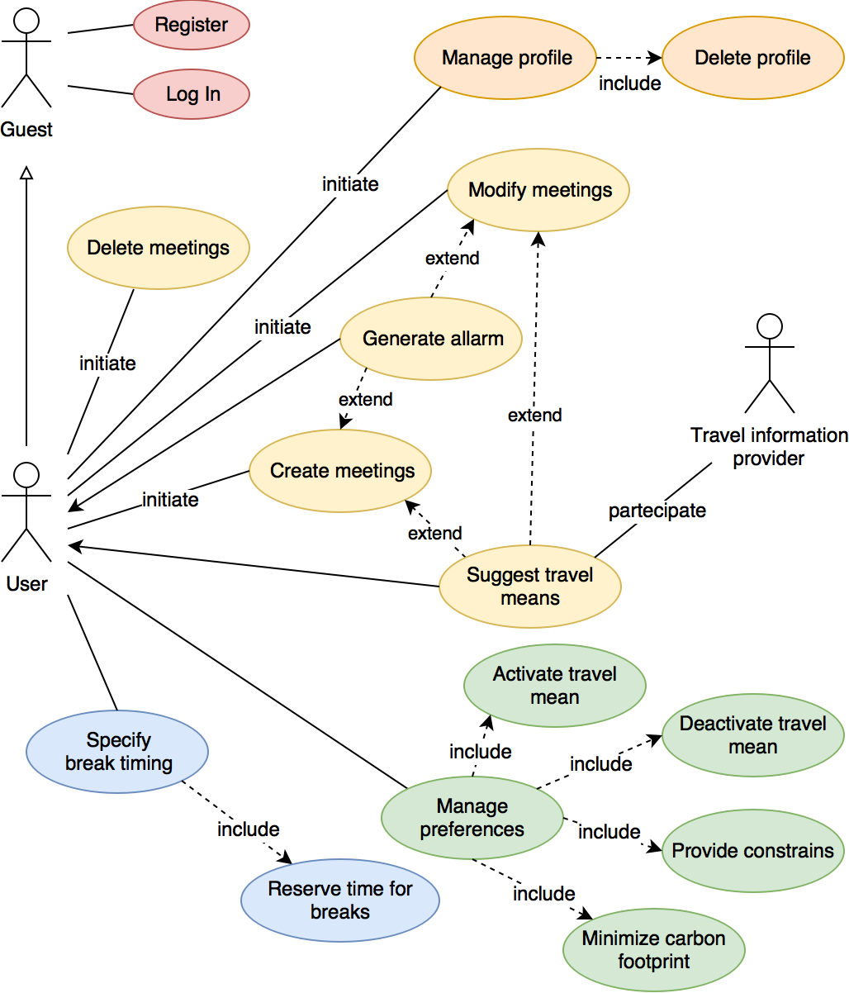
Use case diagram
Davide Rossetto – Alessandro Tatti
Notes:
the user can:
-register to the service (for example typical use cases are register and login)
-manage his profile and delete it
-create meeting and modify it. in this case,if a meeting doesn’t respect the constraints, the system will generate an alarm (for example the insertion date is later than the date of the meeting).
-manage preferences like select travel mean, minimize the carboon footprint
-specify break time

Slide 9
Functional requirements
The user must log in successfully.
The user must enter information in the form:
Start time
End time
Duration
The system must verify that the date is behind the insertion date.
The system must check that the available time (duration time) is sufficient for the break.
Once the information are verified, the system must update the database.
The system must alert the user about the selected time interval.
The system must send an error message if an incorrect date or time space is not available.
Davide Rossetto – Alessandro Tatti
Notes:
when the user create create a break or a meeting, he must enter the start time, end time and the duration; the system controls information and once the information is verified update the db.

Slide 10
Non – functional requirements
Reliability 99.9%
Availability 99%
Security
Every communication between application server and client must comply the HTTPS protocol.
Communication between different servers must be SSL/TLS encrypted.
Sensitive informations (i.e. password) must be properly stored (i.e. key-hashed salted hash).
Maintainability
Portability
Davide Rossetto – Alessandro Tatti

Slide 11
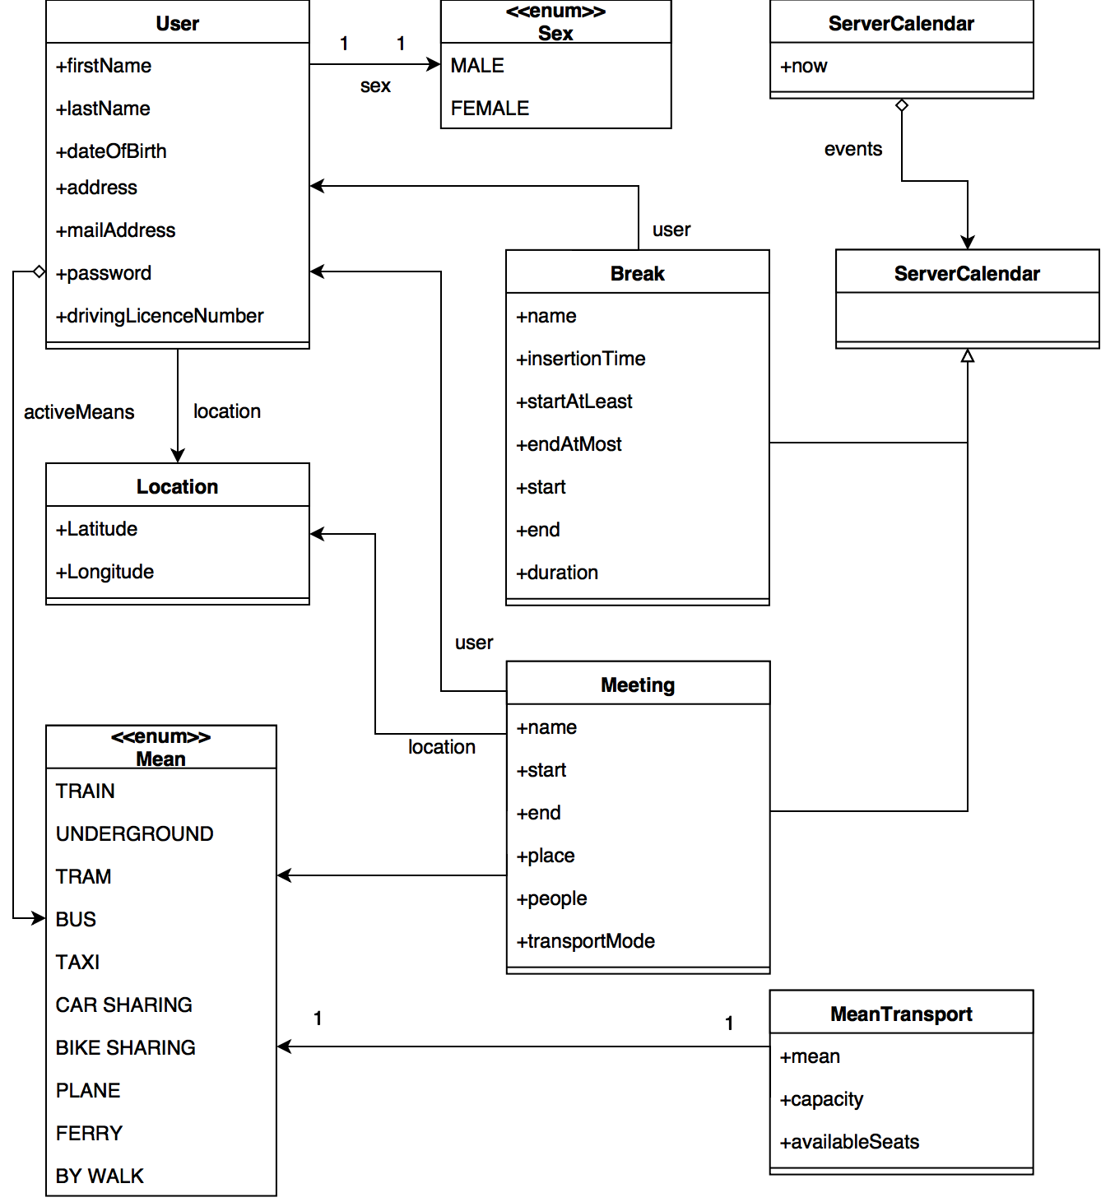
Class Diagram
Davide Rossetto – Alessandro Tatti
Notes:
each meeting is associated location that specify the place (place is specify by latitude and longitude), user that create it and mean of transport that used to go to meeting. it’ s identified by name, start time, end time and number of people

Slide 12
Formal analysis using Alloy
The assertions that we check using Alloy are:
No overlap
Available seats imply higher capacity of the means transport
Duration of the break is equal to difference between end and start time
Davide Rossetto – Alessandro Tatti
Notes:
We use alloy to formal analysis. This part is composed by four parts:
Signature: we use two abstract signatures:
the first is event: it’s extended by meeting and break
and the second is mean that is extended by many type of means of transport.
In this part we specify which attributes has each seignature.
The second part is the definition of predicates, rules that system element must be respect; for example when the users deletes meeting in the timetable there’s a event in minus.
The third part is the fact definition,like no overlapping position
And the last part is assertion like vedi sopra.

Slide 13
Firma convenzione Politecnico di Milano e Veneranda Fabbrica del Duomo di Milano
Design Document
Aula Magna – Rettorato
Mercoledì 27 maggio 2015

Slide 14
High level components
Database: contains all the data structures and entities concerning data storage. This level does not contain any application logic.
Application Server: the layer that contains all the application logic and key algorithms of the system.
Web Server: the Layer that provides all the web pages to the web-based application
Mobile Application: the Presentation Layer of the mobile application.
Web Browser: the Presentation Layer of the web-based application. It just renders the pages obtained from the Web server and executes its scripts.
Davide Rossetto – Alessandro Tatti
Notes:
First of all let’s talk about high level components.
Maybe the most important design decision exposed in this document.
We decided to divide the system into 5 main sub-systems:
the DATABASE:
the system’s data layer, it contains all the data structures and entities responsible for data storage and management.
then we have the APPLICATION SERVER:
the layer that contains all the application logic, key algorithms and also the logics needed to interface with the external systems.
the WEB SERVER:
the Layer that provides all the web pages to the web-based application
moving on the presentation layer we find the MOBILE APPLICATION and WEB BROWSER
respectively dedicated to mobile devices and web browsers, them only includes presentation logic and allows the users to access our APIs graphically through a UI.

Slide 15
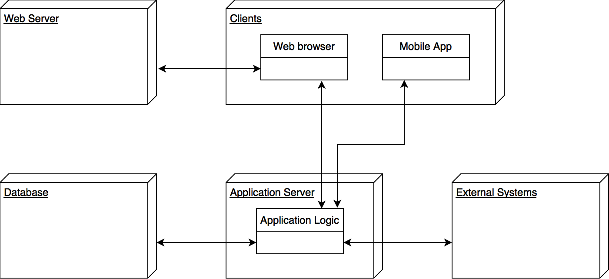
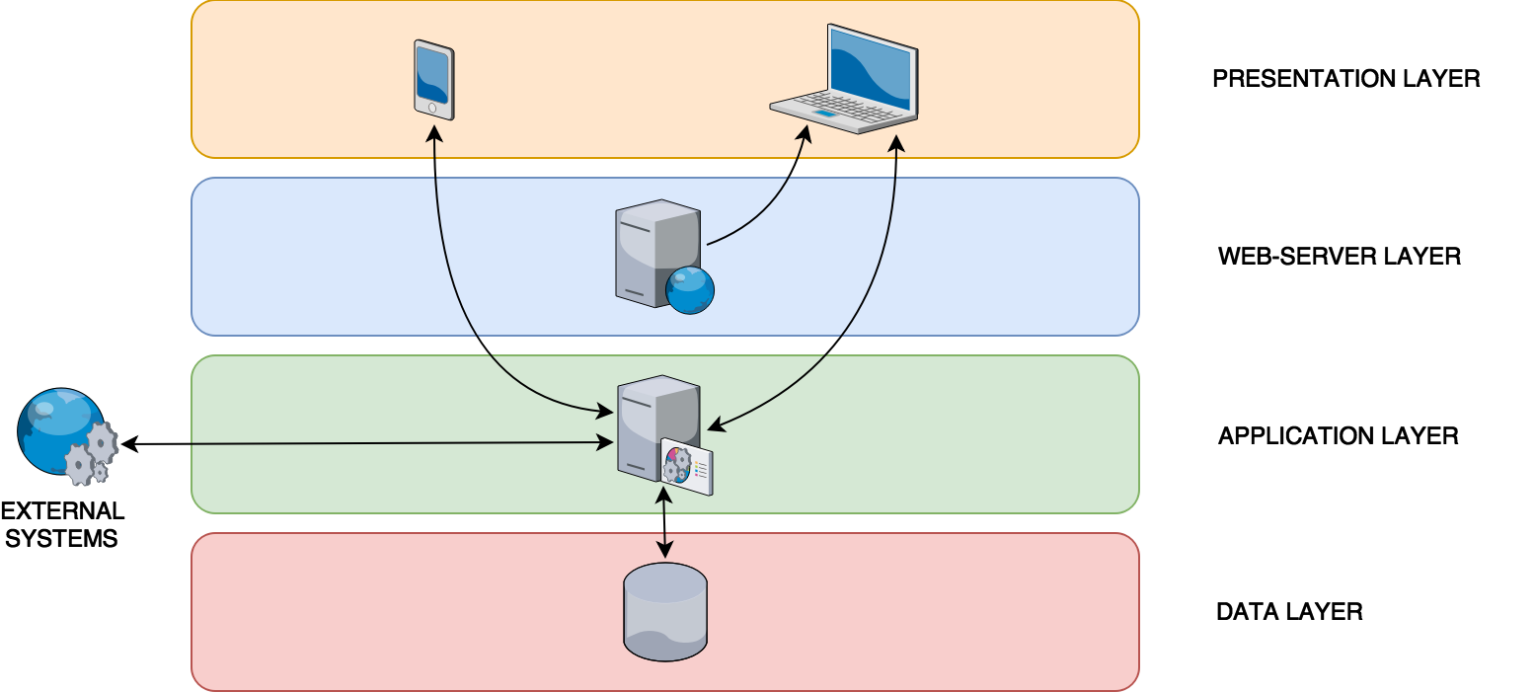
High level components
High-level components of the system.
Layer structure of the system.
Davide Rossetto – Alessandro Tatti
Notes:
In this slide we can see how we designed the interaction between the subsystems.
let’s say that the APPLICATION SERVER plays the role of the kernel of our system:
it interacts with all the others subsystems except for the web server that, as said, only provides static web pages.
Moreover the APPLICATION SERVER interacts also with external systems such as Travel Information Providers.
This architectural choice leads to a 4-layer structure as shown in the bottom-right diagram.

Slide 16
Application Server
This layer must handle business logic, data layer connections, and application access modes from different clients and external systems.
Application Server must provide a means of interfacing with the Web Server and mobile clients through specific APIs in order to separate the different levels from their individual implementation.
The main business logic modules must include:
UserManager
EventManager
MapManager
Travel Information Providers (i.e., ATM, Trenord, Alitalia, etc.)
NotificationManager
Davide Rossetto – Alessandro Tatti
Notes:
Let’ focus on the APPLICATION SERVER
The main feature of Application Server is the specific business logic modules that describe business rules and workflows for each feature provided by the application itself.
Application Server must provide a means of interfacing with the Web Server and mobile clients through specific APIs in order to separate the different levels from their individual implementation.
It must provide a way to communicate with external systems by adapting the application to existing external infrastructures.
The interface with the data layer must be managed by a dedicated persistence unit to ensure that only the Application Server can access the database.
The main business logic modules must include:
USER MANAGER: this module must manage all the logics concerning to user account creation, login and management.
EVENT MANAGER: this module must contain all the logic needed to create and modify meetings and breaks. It must guarantee the consistency of the model preventing from overlapping among events.
MAP MANAGER: this module must contain all the logic used to locate users and meetings.
TRAVEL INFORMATION PROVIDER: this module must be able to interface with external agents
NOTIFICATION MANAGER: this module must be able to notify the user when it is necessary to do so (e.g.
an user tries to insert a meeting that overlaps with a previous one).

Slide 17
Application Server Implementation
In this layer the central character is JEE7. This choice grants us several benefits such as security, reliability and availability.
More specifically:
GlassFish Server as Application Server implementation;
Enterprise JavaBeans (EJB)
JavaPersistenceAPI (JPA)
JAX-RS to implement proper RESTful APIs
Davide Rossetto – Alessandro Tatti
Notes:
Going deeply at implementation level we chose to implement our Application server in JEE,
to use GlassFish as server implementation,
Enterprise Java Beans WEB CONTAINER as runtime environment for our software,
Java Persistence API to handle data management,
JAX-RS to implement proper RESTful APIs

Slide 18
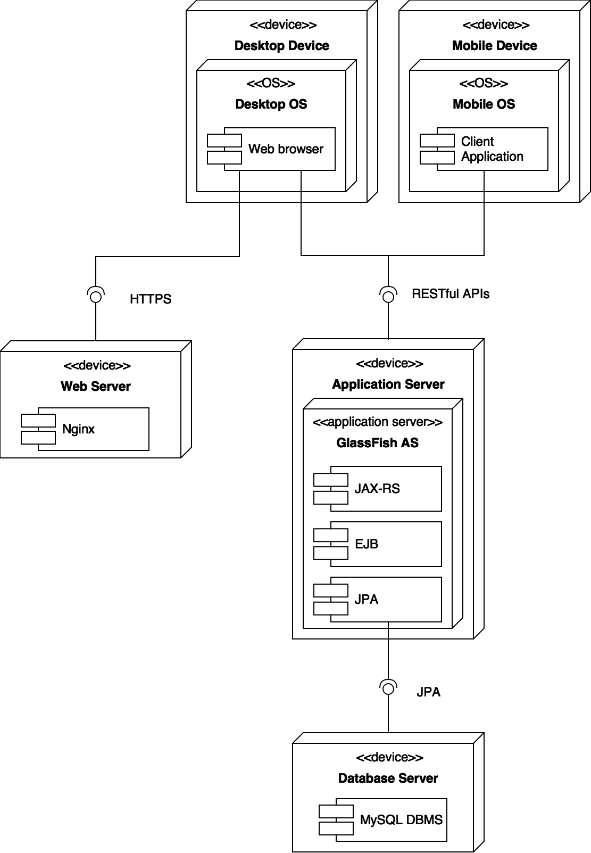
Deployment view
High-level components of the system.
Deployment view
Davide Rossetto – Alessandro Tatti
Notes:
The deployment view kind of summarise the architectural and implementation choices:
We can see in detail how the moules previously introduced interact with each others and which components they include.

Slide 19
Implementation, Integration and Test Plan
Elements to be integrated
The subsystems to integrate are as follows:
Database Tier
Application Logic Tier
Web Tier
Client Tier
Davide Rossetto – Alessandro Tatti
Notes:
The integration test phase for the system will be structured according to the architectural division in levels as described previously.
The subsystems to be integrated are the following:
DATABASE TIER
APPLICATION LOGIC TIER WEB TIER CLIENT TIER
For the integration testing process, we decide to follow a bottom-up approach.
This choice is natural since the integration testing can start from the smaller and the lowest level
components, which have already been tested at the drive level, and do not depend on other components or not already developed components.

